Slide 1
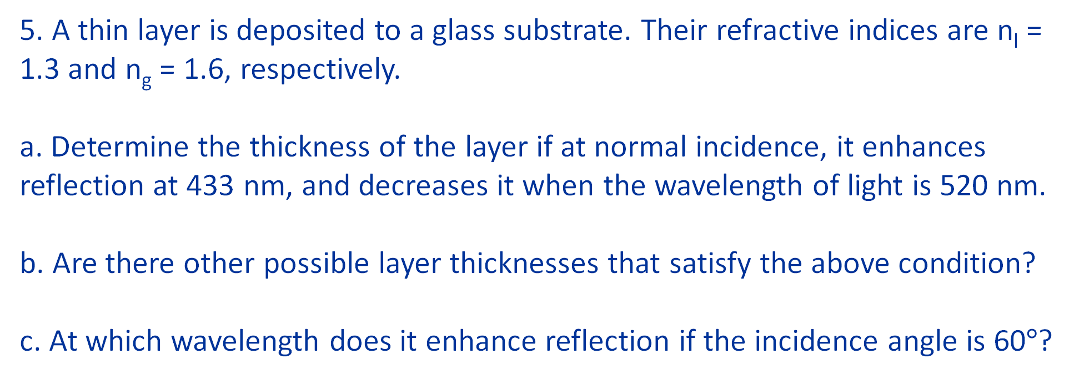
5. A thin layer is deposited to a glass substrate. Their refractive indices are n_{l} = 1.3 and n_{g} = 1.6, respectively.
a. Determine the thickness of the layer if at normal incidence, it enhances reflection at 433 nm, and decreases it when the wavelength of light is 520 nm. b. Are there other possible layer thicknesses that satisfy the above condition?
c. At which wavelength does it enhance reflection if the incidence angle is 60$°$?

Slide 2

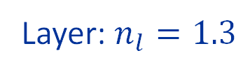

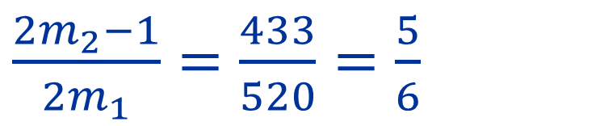


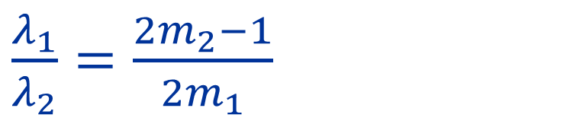


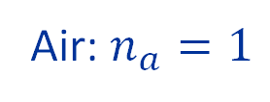

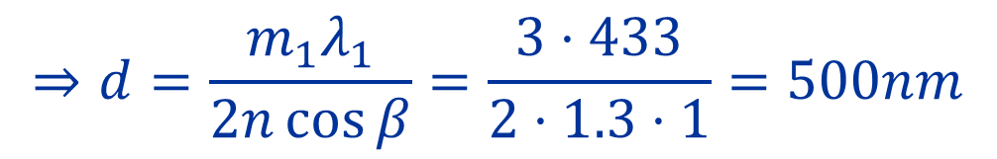
$2nd\cos{β}=m_{1}λ_{1}$ $⇒$ Constructive
$2nd\cos{β}=\left(m_{2}−\frac{1}{2}\right)λ_{2}⇒$ Destructive
$$α$$
$m_{1}λ_{1}= \left(m_{2}−\frac{1}{2}\right)λ_{2}$
Air: $n_{a}=1$
$\frac{λ_{1}}{λ_{2}}=\frac{{2m}_{2}−1}{{2m}_{1}}$
$$β$$
$$d$$
Layer: $n_{l}=1.3$
$\frac{{2m}_{2}−1}{{2m}_{1}}=\frac{433}{520}=\frac{5}{6}$
$⇒m_{1}=3, m_{2}=3$
$$⇒d=\frac{m_{1}λ_{1}}{2n\cos{β}}=\frac{3⋅433}{2⋅1.3⋅1}=500nm$$
Glass: $n_{g}=1.6$

Slide 3




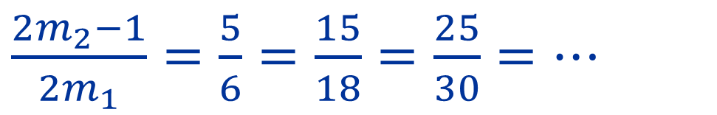

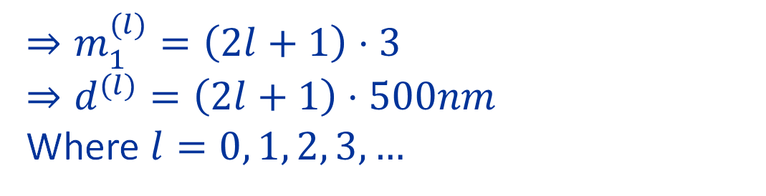
$2nd\cos{β}=m_{1}λ_{1}$ $⇒$ Constructive
$2nd\cos{β}=\left(m_{2}−\frac{1}{2}\right)λ_{2}⇒$ Destructive
$\frac{{2m}_{2}−1}{{2m}_{1}}=\frac{5}{6}=\frac{15}{18}=\frac{25}{30}=…$
$$α$$
Air: $n_{a}=1$
$⇒m_{1}=3, m_{2}=3⇒d=500nm$
$$d$$
$$β$$
$⇒m_{1}′=9, m_{2}′=8⇒d′=1500nm$
Layer: $n_{l}=1.3$
$⇒m_{1}′′=15, m_{2}′′=13⇒d′′=2500nm$
$⇒m_{1}^{(l)}=\left(2l+1\right)⋅3$ $⇒d^{(l)}=\left(2l+1\right)⋅500nm$
Where $l=0, 1, 2, 3, …$
Glass: $n_{g}=1.6$

Slide 4


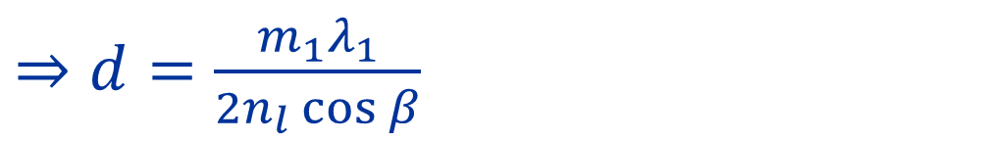

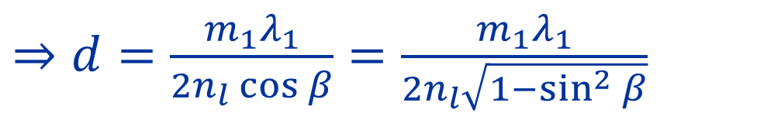
$2nd\cos{β}=m_{1}λ_{1}$ $⇒$ Constructive
$2nd\cos{β}=\left(m_{2}−\frac{1}{2}\right)λ_{2}⇒$ Destructive
$⇒m_{1}=3, m_{2}=3$
$$α$$
Air: $n_{a}=1$
$⇒d=\frac{m_{1}λ_{1}}{2n_{l}\cos{β}}$
$$d$$
$$β$$
Snell’s law: $n_{a}\sin{α}$= $n_{l}\sin{β}$
$\sin{β}=\frac{n_{a}}{n_{l}}\sin{α}=\frac{1}{1.3}⋅\frac{\sqrt{3}}{2}$
Layer: $n_{l}=1.3$
$⇒d=\frac{m_{1}λ_{1}}{2n_{l}\cos{β}}=\frac{m_{1}λ_{1}}{2n_{l}\sqrt{1−\sin^{2}{β}}}$
Glass: $n_{g}=1.6$
$⇒d=670nm$

